Slide 1
Pre-Calc Monday 4-27-15
Today, we will be able to…
Describe what sigma notation is and represents
Write out sigma notation in expanded form
Find the sum of a sigma notation
Write a series in sigma notation
We will show we can do this by…
Asking and answering questions
Completing guided practice problems
Completing the book work assignment
To know how well we are learning this, we will look for…
Correct answers
It is important for us to learn this (or be able to do this) because....
This chapter is an introduction to the study of discrete mathematics. Sequences and series are used in calculus and statistics, which translates to multiple job professions such as engineering and statisticians.
Tomorrow we will…
Practice what we learn today using sigma notation
Turn in:
12.1 - 12.3 Review Worksheet
Discussion/Notes/Guided Practice
12-5 Sigma Notation and the nth Term
Assignment
A#12.5 page 798 #15-39odd
Friday we…
Took the Chapter 11 test retake
Reviewed the concepts from sections 12.1 – 12.3
Tues: Practice 12.5 #1 (hand out Ch. 12 Review)
Wed: Practice 12.5 #2
Thurs: Review due
Fri: Ch 12 test
Chapter 12 Test
Fri May 1

Slide 2
Sigma Notation:
Sigma Notation of a Series
For any sequence $a_{1}, a_{2}, a_{3}, …$, the sum of the first k terms may be written:

Slide 3
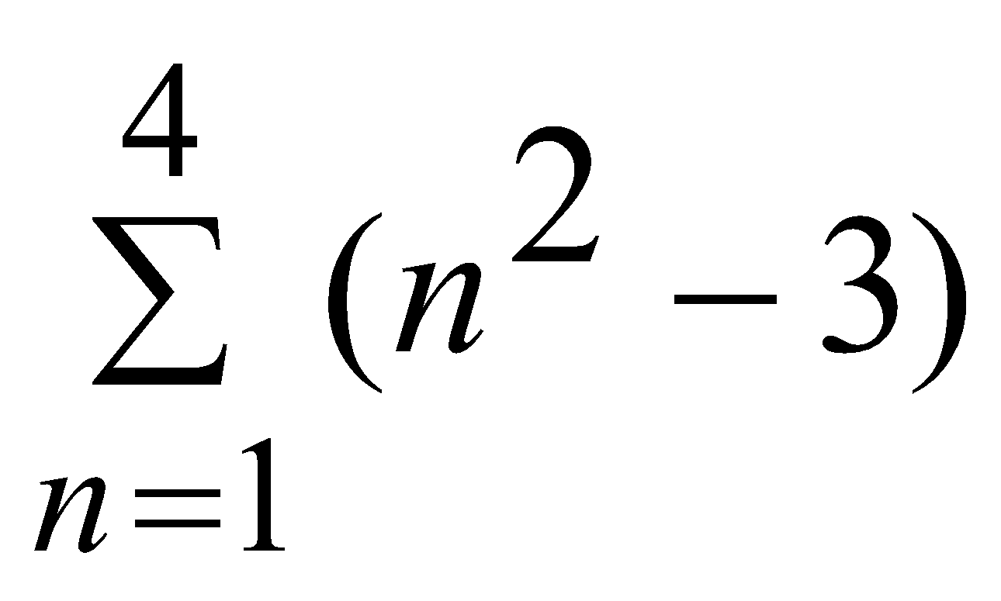
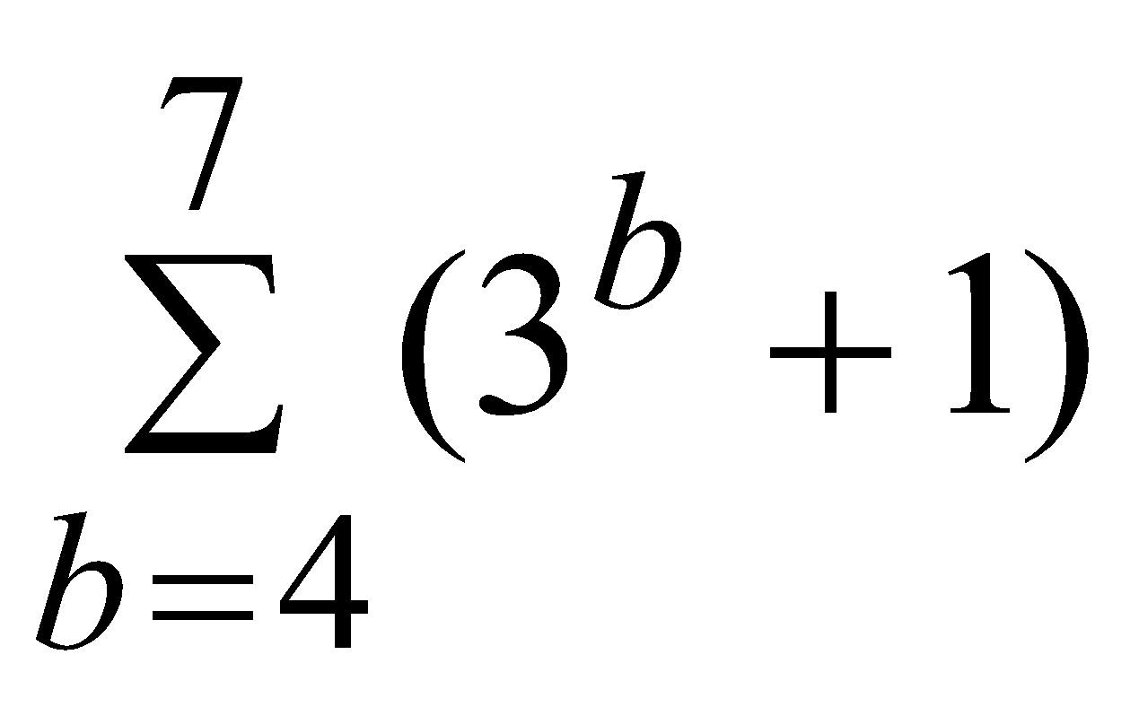
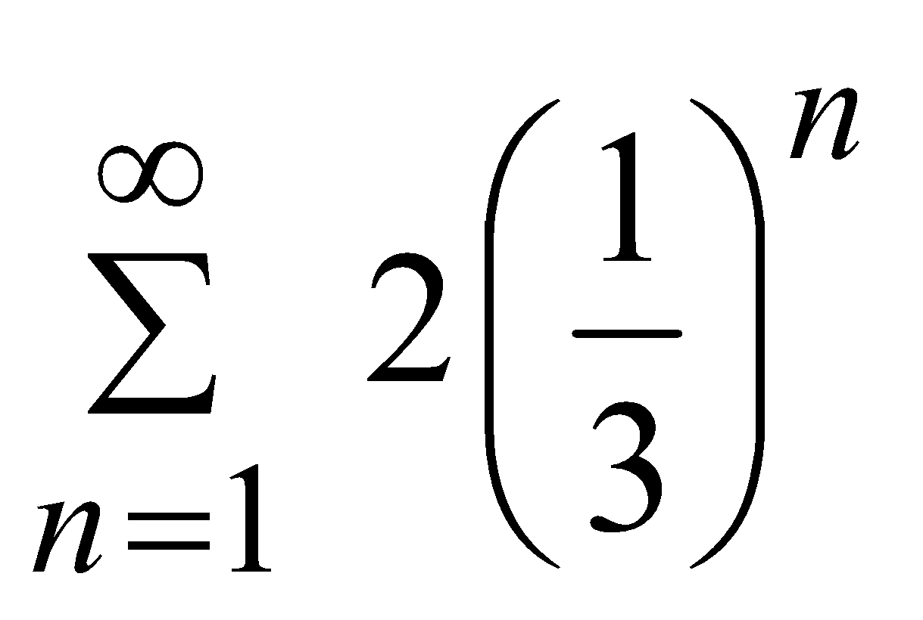
Example #1: Write each expression in expanded form and then find the sum.

Slide 4
Example #2: During a nine-hole charity golf match, one player presents the following proposition: The loser of the first hole will pay $1 to charity, and each succeeding hole will be worth twice as much as the hole immediately preceding it.
a. How much would a losing player pay on the 4th hole?
b. How much would a player pay if he or she lost all nine holes?
c. Represent this sum using sigma notation.

Slide 5
Example #3: Express each series using sigma notation.
a. 16 + 19 + 22 + 25 + … + 61 b. 15 + 24 + 35 + 48 + … + 143

Slide 6
Example #4: Express the series using sigma notation.
N FACTORIAL

Slide 7
Example #5: Express the series using sigma notation.

Slide 8
A#12.5 page 798
#15 – 39 odd

Slide 9
Pre-Calc Tuesday 4-28-15
Today, we will be able to…
Describe what sigma notation is and represents
Write out sigma notation in expanded form
Find the sum of a sigma notation
Write a series in sigma notation
We will show we can do this by…
Checking and discussing the book work assignment
Completing the 12.5 Practice Worksheet
To know how well we are learning this, we will look for…
Correct answers
It is important for us to learn this (or be able to do this) because....
This chapter is an introduction to the study of discrete mathematics. Sequences and series are used in calculus and statistics, which translates to multiple job professions such as engineering and statisticians.
Tomorrow we will…
Take the Chapter 11 Test Retake and continue working with section 12.5.
Check in and discuss:
12.5 page 798 #15-39 odd
Assignment
12.5 Practice #1 Worksheet
TURN IN at end of hour!!!
Chapter 12 Review…due Thursday!!!
Yesterday we learned how to…
Describe what sigma notation is and represents
Write out sigma notation in expanded form
Find the sum of a sigma notation
Write a series in sigma notation
Chapter 11 Test Retake
In class Friday 4/24

Slide 10
Pre-Calc Wednesday 4-29-15
Today, we will be able to…
Describe what sigma notation is and represents
Write out sigma notation in expanded form
Find the sum of a sigma notation
Write a series in sigma notation
We will show we can do this by…
Checking and discussing the book work assignment
Completing the 12.5 Practice Worksheet
To know how well we are learning this, we will look for…
Correct answers
It is important for us to learn this (or be able to do this) because....
This chapter is an introduction to the study of discrete mathematics. Sequences and series are used in calculus and statistics, which translates to multiple job professions such as engineering and statisticians.
Tomorrow we will…
Take the Chapter 11 Test Retake and continue working with section 12.5.
Return and discuss:
12.5 Practice #1 Worksheet
Assignment
12.5 Practice #2 Worksheet
TURN IN at end of hour!!!
Chapter 12 Review…due TOMORROW!!!
Yesterday we learned how to…
Describe what sigma notation is and represents
Write out sigma notation in expanded form
Find the sum of a sigma notation
Write a series in sigma notation
Chapter 11 Test Retake
In class Friday 4/24

Slide 11
Pre-Calc Thursday 4-30-15
Today, we will be able to…
Demonstrate growth over chapter 12
Find the nth term of an arithmetic and geometric sequence
Find the arithmetic means of an arithmetic and geometric sequence
Find the sum of n terms of an arithmetic and geometric series
Describe what sigma notation is and represents
Write out sigma notation in expanded form
Find the sum of a sigma notation
Write a series in sigma notation
We will show we can do this by…
Completing the chapter 12 post test
Discussing the Chapter 12 review & 12.5 Practice #2
To know how well we are learning this, we will look for…
Correct answers
It is important for us to learn this (or be able to do this) because....
This chapter is an introduction to the study of discrete mathematics. Sequences and series are used in calculus and statistics, which translates to multiple job professions such as engineering and statisticians.
Tomorrow we will…
Take the chapter 12 test.
Discuss:
12.5 Practice #2
Chapter 12 Review
Chapter 12 Post Test
Complete the Success Criteria Activity for Chapter 12
Yesterday we…
Describe what sigma notation is and represents
Write out sigma notation in expanded form
Find the sum of a sigma notation
Write a series in sigma notation
Chapter 12 Test TOMORROW

Slide 12
Pre-Calc Friday 5-1-15
Today, we will be able to…
Find the nth term of an arithmetic and geometric sequence
Find the arithmetic means of an arithmetic and geometric sequence
Find the sum of n terms of an arithmetic and geometric series
Describe what sigma notation is and represents
Write out sigma notation in expanded form
Find the sum of a sigma notation
Write a series in sigma notation
We will show we can do this by…
Completing the Chapter 12 test
To know how well we are learning this, we will look for…
Correct answers
It is important for us to learn this (or be able to do this) because....
This chapter is an introduction to the study of discrete mathematics. Sequences and series are used in calculus and statistics, which translates to multiple job professions such as engineering and statisticians.
Tomorrow we will…
Begin Chapter 10…take a pre-test and look at the first section.
Chapter 12 Test
Yesterday we…
Reviewed chapter 12 and took the post-test to demonstrate growth over the chapter.

