Slide 1
Pre-Calc Tuesday 5-19-15
Today, we will be able to…
Identify and use parabolas
Write equations of parabolas
Find critical points of parabolas
Graph parabolas
We will show we can do this by…
Asking and answering questions
Completing the bookwork assignment
To know how well we are learning this, we will look for…
Correct answers
It is important for us to learn this (or be able to do this) because....
This chapter is an introduction to the study of analytic geometry. Analyzing area, figures, and 3-D space are important concepts in daily life and many professions such as design and engineering.
Tomorrow we will….
Practice identifying and using parabolas, finding their critical points, and graphing them.
Discussion/Notes/Guided Practice
10.5 Parabolas
Assignment
A#10.5 Pg. 659 #13, 15, 17, 19, 25
Chapter 10 test: Wed 5/27
Final Exam:
5th hour: Thurs 5/28
1st hour: Fri 5/29
No School:
Friday 5/22
Monday 5/25
Yesterday we…
Learned to identify and use hyperbolas, write equations of hyperbolas, find critical points of hyperbolas, and graph hyperbolas.

Slide 4
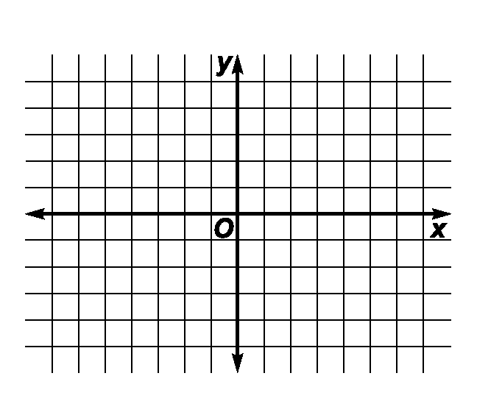
Example #1
Consider the equation $y^{2}+2x=0$. Find the coordinates of the focus, the vertex, and the equations of the directrix and the axis of symmetry. Then graph the parabola.

Slide 5
Example #2
Consider the equation $x^{2}−8x−y+18=0$.
Write the equation in standard form.
Find the coordinates of the focus, the vertex, and the equations of the directrix and the axis of symmetry. Then graph the parabola.

Slide 6
Example #3
Write the equation of a parabola whose vertex is at the origin, and the focus is at (0, -4).

Slide 7
A#10.5 Pg. 659
#13, 15, 17, 19, 25
DUE TOMORROW

