Slide 1
Pre-Calc Thursday 5-7-15
Check in/discuss bookwork from 10.2
A#10.2 Pg. 627 #15-27 odd, 35, 37
A#10.22 Pg. 627 #14-26even, 36, 38, 43, 46, 47
Discussion/Notes/Guided Practice
10.3 Ellipses
Assignment
A#10.2 Pg. 638 638 #16-38, 49 all (Due Monday)
You will have tomorrow in class to work on this!
Today, we will be able to…
Use and determine the standard form of an ellipse
Find center points, major and minor vertices, and foci points of ellipses
We will show we can do this by…
Asking and answering questions
Completing the book work assignment
To know how well we are learning this, we will look for…
Correct answers
It is important for us to learn this (or be able to do this) because....
This chapter is an introduction to the study of analytic geometry. Analyzing area, figures, and 3-D space are important concepts in daily life and many professions such as design and engineering.
Tomorrow we will….
Practice using and determining the standard form of an ellipse, and finding center points, major and minor vertices, and foci points of ellipses.
Yesterday we…
Practiced graphing a circle and writing an equation of a circle.

Slide 2
10-3 Ellipses

Slide 5
Guided Practice for Example 1:
Write the equation of the ellipse graphed at the right in standard form. Then find the coordinates of its foci.

Slide 6
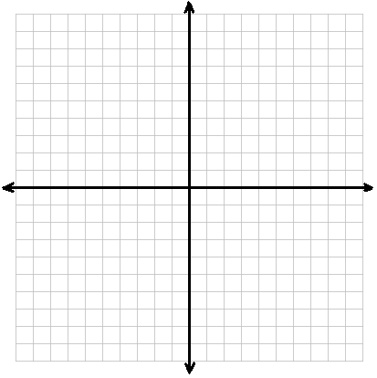

Slide 7
Guided Practice for Example 2:
For the equation of the ellipse, find the coordinates of the center, foci, and vertices. Then graph the equation.
$\frac{x^{2}}{81}+\frac{{(y−4)}^{2}}{49}=1$

Slide 9
Guided Practice for Example 3:
For the equation of the ellipse, find the coordinates of the center, foci, and vertices. Then graph the equation.
${9x}^{2}+{4y}^{2}−18x+16y=11$

