Slide 1
Pre-Calc Tuesday 5-5-15
Turn in Getting Ready for Ch 10 WS
Discussion/Notes/Guided Practice
10.2 Circles
Assignment (Due Wednesday)
A#10.2 Pg. 627 #15-27 odd, 35, 37
Today, we will be able to…
Write equations of circles
Graph circles
We will show we can do this by…
Asking and answering questions
Completing the guided practice problems
Completing the book work assignment
To know how well we are learning this, we will look for…
Correct answers
It is important for us to learn this (or be able to do this) because....
This chapter is an introduction to the study of analytic geometry. Analyzing area, figures, and 3-D space are important concepts in daily life and many professions such as design and engineering.
Tomorrow we will….
Practice writing equations of circles and graphing circles
Yesterday we…
Reviewed how to use the midpoint and distance formulas as well as took the chapter 10 pretest.
Wed: Practice 10.2
Thurs: 10.3 notes (Ellipses)
Fri: Practice 10.3

Slide 6
Standard Form of the Equation of a Circle:

Slide 8
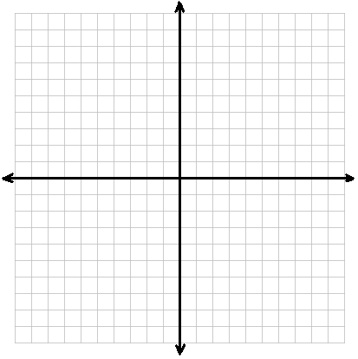
Guided Practice for Example 1:
Write the standard form of the equation of the circle described below. Then graph the equation.
Center at $(−1, 4)$and tangent to $x=3$

Slide 10
Guided Practice for Example 2:
The equation of a circle is $2x^{2}+2y^{2}−20x+8y+34=0$.
a. Write the standard form of the equation.
b. Find the radius and coordinates of the center.
c. Graph the equation.

Slide 12
Guided Practice for Example 3:
Write the equation of a circle that passes through the point at $(1,5)$and has its center at $(−2, 1).$

Slide 13
A#10.2 Pg. 627
#15-27 odd, 35, 37
DUE TOMORROW

