Slide 1
Geometry Tuesday 4-28-15
Today, we will learn to…
Recognize and apply the properties of trapezoids
We will show we can do this by…
Answering and asking questions
Completing Guided Practice Problems
Completing the book work assignment
To know how well we are learning this, we will look for…
Correct answers
It is important for us to learn this (or be able to do this) because....
Understanding the properties of polygons, and in particular quadrilaterals, is essential to the success in fields such as engineering, architecture, and design.
Tomorrow we will…
Practice recognizing and applying the properties of rhombi, squares, and trapezoids.
Check in and discuss
A#8.5 pg 434 #4-9, 12-20, 22, 26-31, 33
Discussion/Notes/Guided Practice
8.6 – Trapezoids
Assignment
A#8.6 page 442 #7-18, 22-25
Yesterday we learned how…
To recognize and apply the properties of both rhombi and squares.
Wed: Thurs & Fri:
Practice 8.5/8.6 Activity and Ch. 8 Project

Slide 2
Review
List the properties of a:
Parallelogram: Rectangle: Rhombi: Squares:
* * * *
* * * *
* * * *
* *
*

Slide 3
8-6 Trapezoids
A quadrilateral with EXACTLY one pair of parallel sides.

Slide 4
Isosceles Trapezoids

Slide 5
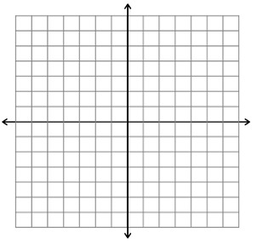
Example #1

Slide 6
Guided Practice for Example #1

Slide 7
Median of a Trapezoid
Segment that joins the midpoints of the legs of a trapezoid.

Slide 8
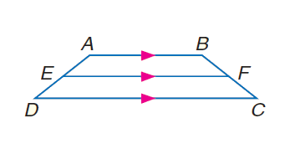
Trapezoid Median Theorem

Slide 9
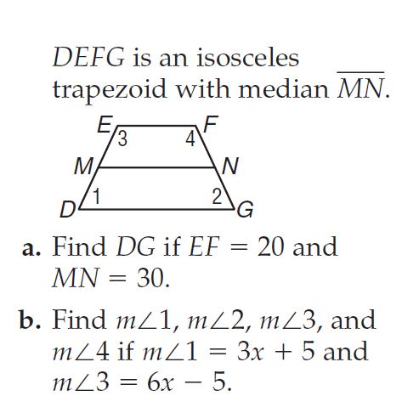
Example #2

Slide 10
Guided Practice for Example #2

Slide 11
A#8.6 page 442
#7-18, 22-25

