Slide 1
Geometry Monday 4-27-15
Today, we will learn to…
Recognize and apply the properties of rhombi
Recognize and apply the properties of squares
We will show we can do this by…
Answering and asking questions
Completing Guided Practice Problems
Completing the book work assignment
To know how well we are learning this, we will look for…
Correct answers
It is important for us to learn this (or be able to do this) because....
Understanding the properties of polygons, and in particular quadrilaterals, is essential to the success in fields such as engineering, architecture, and design.
Tomorrow we will learn about…
The properties of trapezoids.
Turn in
A#8.4 pg 428 #10-34, 52-57
Review 8.1-8.4 pg 452-4 #9-29 all
Discussion/Notes/Guided Practice
8.5 – Rhombi and Squares
Assignment
A#8.5 page 434 #12-20, 22, 26-31, 33
Friday we…
Either took the Chapter 7 test retake or reviewed sections 8.1 – 8.4 (pg 452-4 #9-29 all)
Tues: Wed: Thurs & Fri:
8.6 notes Practice 8.5/8.6 Activity and Ch. 8 Project

Slide 2
Review
List the properties of a:
Parallelogram: Rectangle:
* *
* *
* *
*
*

Slide 3
8-5 Rhombi and Squares
A Rhombus is a special type of parallelogram
*
*
*
*

Slide 4
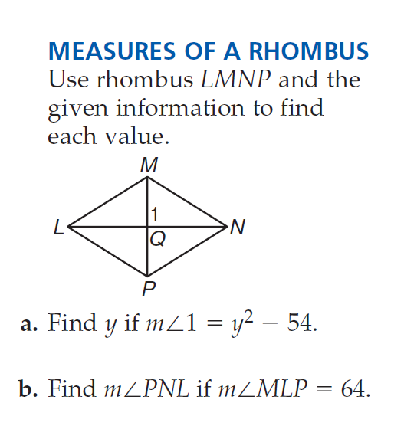
Example #1

Slide 5
Guided Practice for Example #1

Slide 6
Squares
If a quadrilateral is both a rhombus and a rectangle, then it is a square.
*
*
*

Slide 7
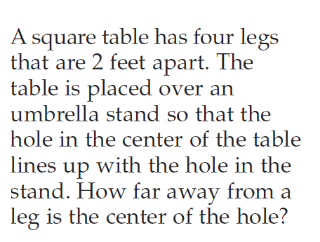
Example #2

Slide 8
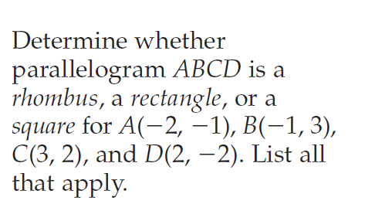
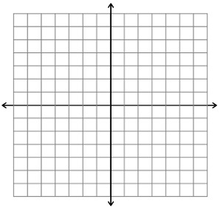
Example #3

Slide 9
Guided Practice for Example #3

Slide 10
Recap
Rhombi:
Squares:
Today, we will learn to…
Recognize and apply the properties of rhombi
Recognize and apply the properties of squares
We will show we can do this by…
Answering and asking questions
Completing Guided Practice Problems
Completing the book work assignment
To know how well we are learning this, we will look for…
Correct answers
It is important for us to learn this (or be able to do this) because....
Understanding the properties of polygons, and in particular quadrilaterals, is essential to the success in fields such as engineering, architecture, and design.
Tomorrow we will learn about…
The properties of trapezoids.

Slide 11
A#8.5 page 434
#12-20, 22, 26-31, 33

