Slide 1
Geometry Tuesday 5-26-15
Today, we will learn how to…
Write equations of circles
Use equations of circles to graph them
We will show we can do this by…
Asking and answering questions
Completing 10.8 Practice WS
To know how well we are learning this, we will look for…
Correct answers
It is important for us to learn this (or be able to do this) because....
Understanding the properties of circles is essential to the success in fields such as engineering, architecture, and design.
Tomorrow we will…
Review for Chapter 10 test.
Turn in:
10.6 Practice WS
Discussion/Notes/Guided Practice
10.8: Equations of Circles
Assignment:
10.8 Practice Worksheet
Last week we…
Found measure of angles formed by lines intersecting on, inside, or outside the circle.

Slide 2
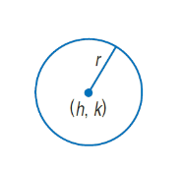
10-8 Equations of Circles
Definition of a circle:
Find the distance from the radius to a point on the circle:

Slide 3
Examples
Write an equation for each circle:
Center at (3, -3), d = 12
Center at (-12, -1), r = 8

Slide 4
Example
A circle with a diameter of 10 has its center in the first quadrant. The lines y = -3 and x = -1 are tangent to the circle. Write an equation of the circle.

Slide 5
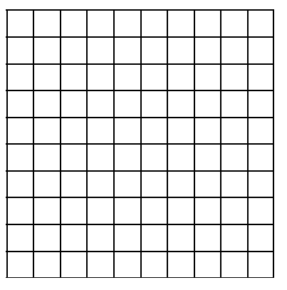
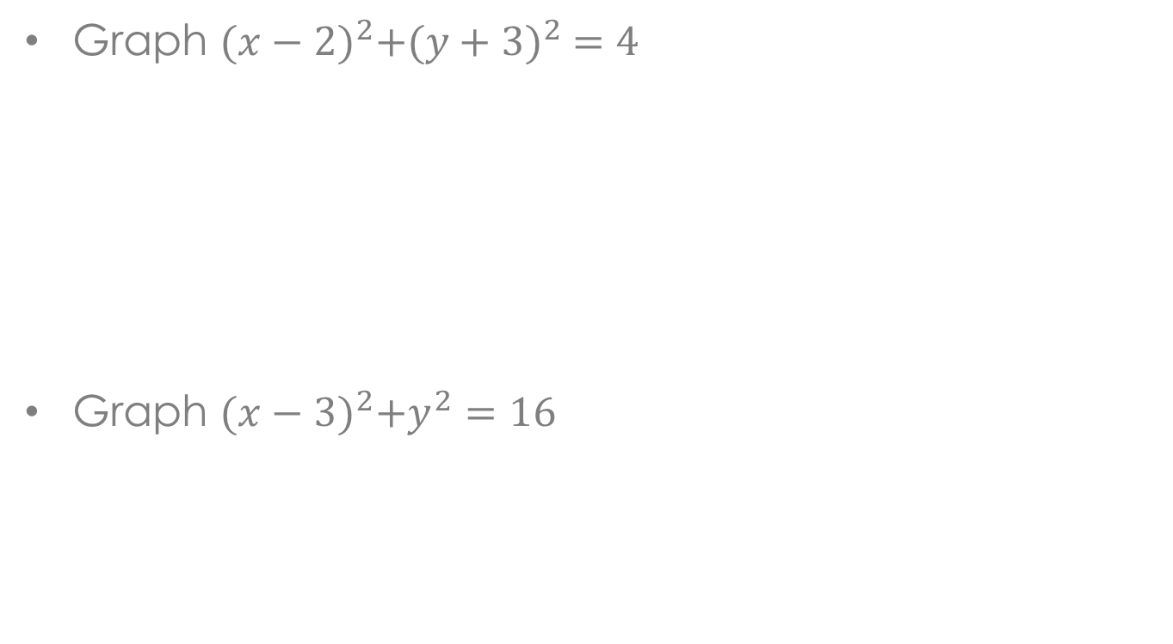
Example
Graph ${(x−2)}^{2}+{(y+3)}^{2} =4$
Graph ${(x−3)}^{2}+y^{2}=16$

