Slide 1
Geometry Friday 5-8-15
Today, we will…
Find the measure of inscribed angles
Find angles of inscribed polygons.
We will show we can do this by…
Asking and answering questions
Completing guided practice problems
Completing the practice worksheet
To know how well we are learning this, we will look for…
Correct answers
It is important for us to learn this (or be able to do this) because....
Understanding the properties of circles is essential to the success in fields such as engineering, architecture, and design.
Next week we will…
Review 10.1 – 10.4, take a quiz on Tuesday over those sections, cover sections 10.5 and 10.6. The chapter 10 test is scheduled for Thursday, May 28.
Discussion/Notes/Guided Practice
10.4 – Inscribed Angles
Assignment:
10.4 Practice Worksheet
Yesterday we…
Practiced sections 10.1 – 10.3.
Quiz
TUESDAY
Sections 10.1 - 10.4

Slide 2
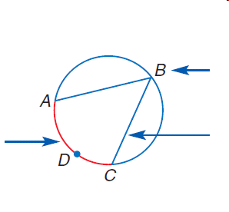
10-4 Inscribed Angles
An inscribed angle is an angle that ______________________
___________________________________________________
___________________________________________________

Slide 3
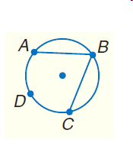
Inscribed Angle Theorem

Slide 4
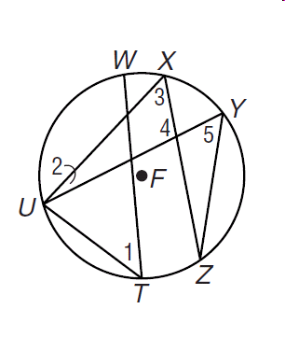
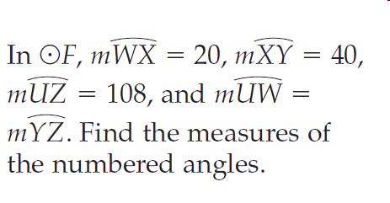
Example #1

Slide 5
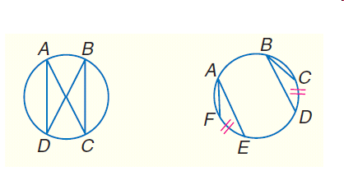
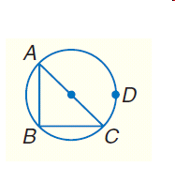
Theorems

Slide 6
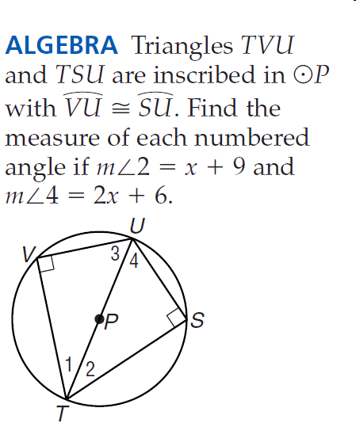
Example #2

Slide 7
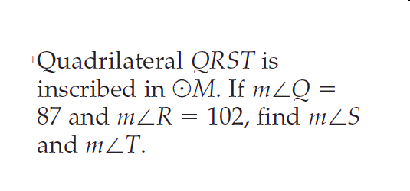
Example #3

Slide 8
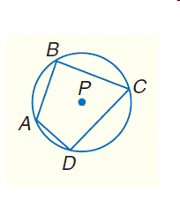
Theorem

Slide 9
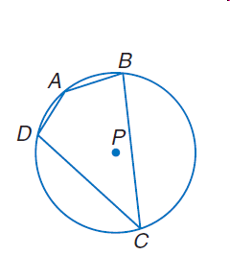
Example #4

