Slide 1
Geometry Tuesday 5-12-15
Today, we will…
Recognize and label major and minor arcs, semicircles, and central angles
Find the arc length.
We will show we can do this by…
Answering and asking questions
Completing guided practice problems
Completing the bookwork assignment
To know how well we are learning this, we will look for…
Correct answers
It is important for us to learn this (or be able to do this) because....
Understanding the properties of circles is essential to the success in fields such as engineering, architecture, and design.
Tomorrow we will…
Recognize and use relationships between arcs, chords, and diameters in circles.
Turn in:
A#10.1 page 526 #16-45 all
Discussion/Notes/Guided Practice
10.2 – Angles and Arcs
Assignment:
A#10.2 page 532 #14-44 even, 45, 47-50
Yesterday we…
Reviewed vocab words (radius, diameter, circumference, center, and chord), identified and used these parts of circles to find missing pieces, and solved problems using the circumference

Slide 2
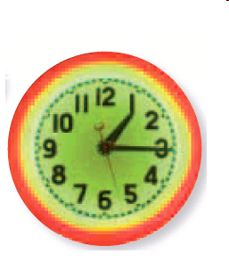
10-2 Angles and Arcs
What kinds of angles do
the hands of a clock form?
A _____________ has the center of the circle as its vertex, and its sides contain two radii of the circle.

Slide 3
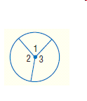
Sum of Central Angles

Slide 4
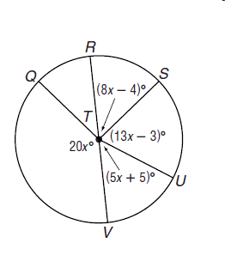
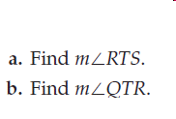
Example #1
RV is a diameter of OT

Slide 5
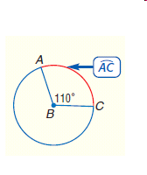
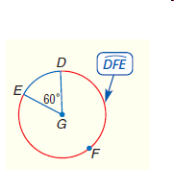
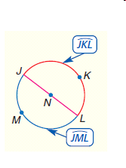
Arcs of a Circle
A central angle separates the circle into two parts, each of which is an _______.

Slide 6
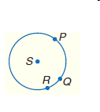
Arc Addition Postulate

Slide 7
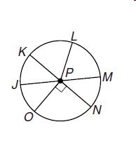
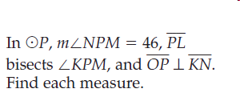
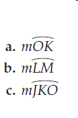
Example #2

Slide 8
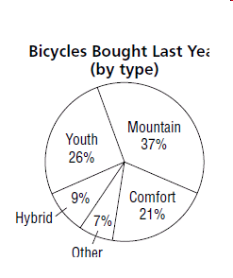
Example #3
a. Find the measurement of the
central angle representing
each category.
b. Is the arc for the wedge named Youth congruent to the arc for the combined wedge named Other and Comfort?

Slide 9
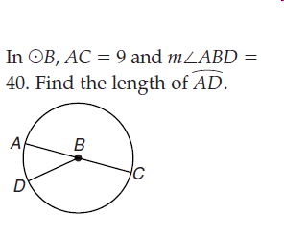
Arc Length
Example:

