Slide 1
Algebra 2 Thursday 5-7-15
Today, we will be able to…
Solve rational inequalities
We will show we can do this by…
Asking and answering questions
Completing guided practice problems
Completing the book work assignment
To know how well we are learning this, we will look for…
Correct answers
It is important for us to learn this (or be able to do this) because....
The concepts in Chapter 8 will help prepare students for Precalculus.
Tomorrow we will…
Review sections 8.1, 8.2, 8.6
Check in/Discuss
Discussion/Notes/Guided Practice
8.6 – Solving Inequalities (part 2)
Assignment
8.6 Solving Inequalities Practice WS
Yesterday we practiced…
Adding and subtracting rational expressions; and simplifying complex fractions that include addition/subtraction.

Slide 2
WARM-UPS

Slide 3
3 Steps to solving Rational Inequalities:
State the excluded values.
Solve the related equation.
Use the values determined in Steps 1 and 2 to divide a number line into intervals.
Test a value in each interval to determine which intervals contain values that satisfy the original inequality.

Slide 4
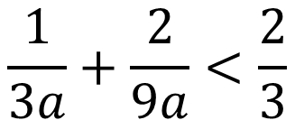
Example #5A: Solve a Rational Inequality
Solve each equation. Check your answers.
$$\frac{1}{3a}+\frac{2}{9a}<\frac{2}{3}$$

Slide 5
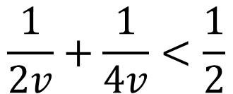
GUIDED PRACTICE #5A: Solve a Rational Inequality
Solve the inequality. Check your answers.
$$\frac{1}{2v}+\frac{1}{4v}<\frac{1}{2}$$

Slide 6
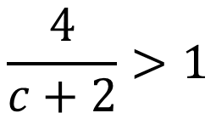
Example #5B: Solve a Rational Inequality
Solve each equation. Check your answers.
$$\frac{4}{c+2}>1$$

Slide 7
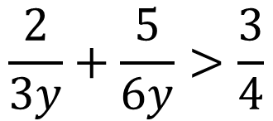
PRACTICE #5B: Solve a Rational Inequality
Solve each equation. Check your answers.
$$\frac{2}{3y}+\frac{5}{6y}>\frac{3}{4}$$

