Slide 1
Algebra 2 Tuesday 5-5-15
Today, we will be able to…
Solve rational equations and check solutions
Eliminate possible solutions from a rational equation
We will show we can do this by…
Asking and answering questions
Completing guided practice problems
Completing the book work assignment
To know how well we are learning this, we will look for…
Correct answers
It is important for us to learn this (or be able to do this) because....
The concepts in Chapter 8 will help prepare students for Precalculus.
Tomorrow we will…
Practice sections 8.1 & 8.2
Thursday: Learn how to solve rational inequalities
Friday: Review section 8.6
Next week: Section 8.3, review chapter, test Friday.
Turn in:
8.2 Skills Practice
Discussion/Notes/Guided Practice
8.6 – Solving Equations (part 1)
Assignment: pg 484 #10-17 all, 24, 25
Yesterday we learned how to…
Add and subtract rational expressions; and simplify complex fractions that include addition/subtraction.

Slide 2
WARM-UPS

Slide 3
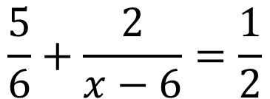
Example #1A: Solve a Rational Equation
Solve each equation. Check your answers.
$$\frac{5}{6}+\frac{2}{x−6}=\frac{1}{2}$$

Slide 4
Example #1B: Solve a Rational Equation
Solve each equation. Check your answers.
$$\frac{7}{12}+\frac{9}{x−4}=\frac{55}{48}$$

Slide 5
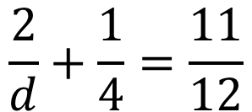
GUIDED PRACTICE #1A: Solve a Rational Equation
Solve each equation. Check your answers.
$$\frac{2}{d}+\frac{1}{4}=\frac{11}{12}$$

Slide 6
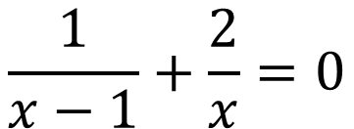
GUIDED PRACTICE #1B: Solve a Rational Equation
Solve each equation. Check your answers.
$$\frac{1}{x−1}+\frac{2}{x}=0$$
I don’t understand
Rate Learning Target: Solve rational equations and check solutions Need practice
I got this!!!

Slide 7
Example #2A: Elimination of Possible solutions
$$\frac{2}{r+1}−\frac{1}{r−1}=\frac{−2}{r^{2}−1}$$

Slide 8
GUIDED PRACTICE #2A: Elimination of Possible solutions
$$\frac{w}{w−1}+w=\frac{4w−3}{w−1}$$

Slide 9
Example #2B: Elimination of Possible solutions
$$\frac{7n}{3n+3}−\frac{5}{4n−4}=\frac{3n}{2n+2}$$

Slide 10
GUIDED PRACTICE #2B: Elimination of Possible solutions
$$\frac{4n^{2}}{n^{2}−9}−\frac{2n}{n+3}=\frac{3}{n−3}$$
I don’t understand
Rate Learning Target: Eliminate possible solutions from a rational equation Need practice
I got this!!!

