Slide 1
Algebra 2 Monday 5-11-15
Today, we will be able to…
Determine the limitations on the domains and ranges of the graphs of rational functions
Graph rational functions that have horizontal and vertical asymptotes
Graph rational functions that have points of discontinuity
We will show we can do this by…
Asking and answering questions
Completing the guided practice problems
Completing the bookwork assignment
To know how well we are learning this, we will look for…
Correct answers
It is important for us to learn this (or be able to do this) because....
The concepts in Chapter 8 will help prepare students for Precalculus.
Tomorrow we will…
Begin reviewing for the Chapter 8 Test
Warm ups
Complete slide below
Discussion/Notes/Guided Practice
8.3 Graphing Rational Equations
Assignment
Page 461 #14-28 EVEN
Friday we practiced…
Solving rational equations and inequalities.

Slide 2
Warm-ups: Simplify the following
$$\frac{t^{2}−t−6}{t^{2}−6t+9}$$
$$\frac{4a+2}{a+b}+\frac{1}{−b−a}$$
$$\frac{2x}{5ab^{2}}+\frac{4y}{3a^{2}b^{2}}$$

Slide 3
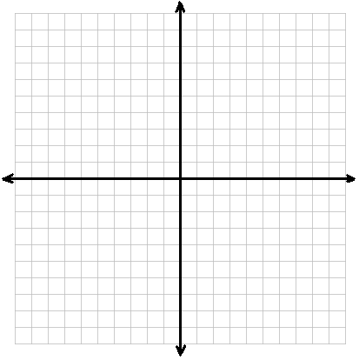
Vertical Asymptotes
If the rational expression of a function is written in simplest form and the function is undefined at x = a, then the line x = a is a vertical asymptote.

Slide 4
Point Discontinuity
If the original function is underfined for x = a, but the rational expression of the function in simplest form is defined for x = a, then there is a hole in the graph at x = a.

Slide 5
Example #1: Limitations on Domain
Determine the equations of any vertical asymptotes and the values of x for any holes in the graph of
$$f\left(x\right)=\frac{x^{2}+6x+8}{x^{2}−16}$$

Slide 6
PRACTICE#1: Limitations on Domain
Determine the equations of any vertical asymptotes and the values of x for any holes in the graphs of:
$$f\left(x\right)=\frac{3}{x^{2}−4x+4}$$
$$g\left(x\right)=\frac{x−1}{x^{2}+4x−5}$$

Slide 7
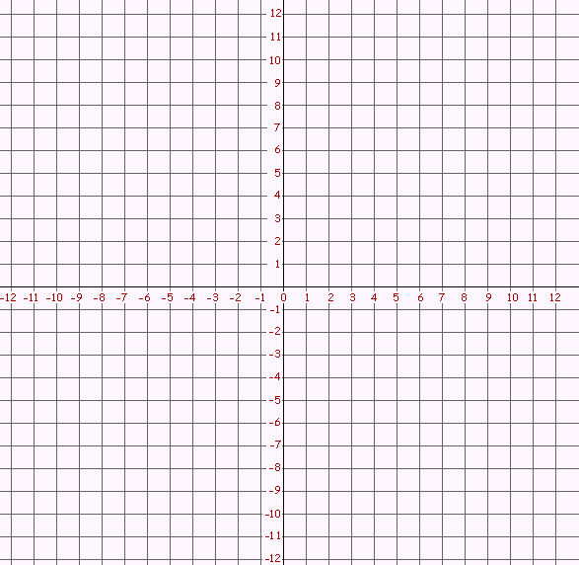
Example #2: Graph with Vertical and Horizontal Asymptotes
Graph $f\left(x\right)=\frac{x+1}{x−1}$

Slide 8
PRACTICE#2A: Graph with Vertical and Horizontal Asymptotes
Graph $f\left(x\right)=\frac{x}{x+1}$

Slide 9
PRACTICE#2B: Graph with Vertical and Horizontal Asymptotes
Graph $f\left(x\right)=\frac{x−5}{x+1}$

Slide 10
Example #3: Graph with Point Discontinuity
Graph $f\left(x\right)=\frac{x^{2}+4x−5}{x+5}$

Slide 11
PRACTICE#3A: Graph with Point Discontinuity
Graph $f\left(x\right)=\frac{x^{2}−25}{x−5}$

Slide 12
PRACTICE#3B: Graph with Point Discontinuity
Graph $f\left(x\right)=\frac{x+2}{x^{2}−x−6}$

