Slide 1
Algebra 2 Friday 5-1-15
Today, we will be able to…
determine the LCM (Least Common Multiple) of polynomials
add rational expressions
subtract rational expressions
simplify complex fractions that include the addition and/or subtraction of rational expressions
We will show we can do this by…
Asking and answering questions
Completing the guided practice problems
Completing the bookwork assignment
To know how well we are learning this, we will look for…
Correct answers
It is important for us to learn this (or be able to do this) because....
The concepts in Chapter 8 will help prepare students for Precalculus.
Tomorrow we will…
Continue looking at examples of how to add and subtract rational expressions.
Discussion/Notes/Guided Practice
8.2 - Adding and Subtracting Rational Expressions PART 1
Assignment
A#8.2 page 454 #18 – 46 evens
Yesterday we practiced…
Simplifying rational expressions and using factoring when necessary; multiplying and dividing rational expressions; and simplifying complex fractions.

Slide 2

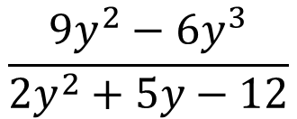
Warm-ups: Simplify the following
$$\frac{9y^{2}−6y^{3}}{2y^{2}+5y−12}$$
$$\frac{b^{3}−a^{3}}{a^{2}−b^{2}}$$
$$\frac{3t+6}{7t−7}∙\frac{14t−14}{5t+10}$$
$$\frac{20xy^{3}}{21}÷\frac{15x^{3}y^{2}}{14}$$

Slide 3
LCM of Polynomials - Notes

Slide 4
Example #1: LCM of Monomials
Find the LCM of the following:
a. $12a^{2}b^{4}$, $27ac^{3}$, and $18a^{5}b^{2}c$
b. $6m^{3}n^{5}$, $42mnp^{2}$, and $36m^{3}n^{4}p$

Slide 5
PRACTICE #1: LCM of Monomials
Find the LCM of the following:
a. $12y^{2}$, $6x^{2}$
b. $16{ab}^{3}$, $5b^{2}a^{2}$, and $20ac$

Slide 6
Example #2: LCM of Polynomials
Find the LCM of each set of polynomials:
a. $q^{2}−4q+4$ and $q^{3}−3q^{2}+2q$
b.${2k}^{3}−5k^{2}−12k$ and $k^{3}−8k^{2}+16k$

Slide 7
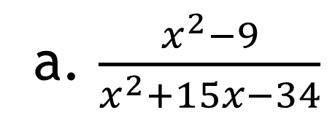
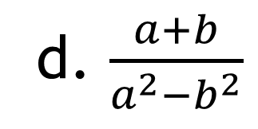
PRACTICE #2: LCM of Polynomials
Find the LCM of each set of polynomials:
a. $x^{2}−2x$ and $x^{2}−4$
b.$x^{3}−4x^{2}−5x$ and $x^{2}+6x+5$

Slide 8
Add and Subtract Rational Expressions - Notes

Slide 9
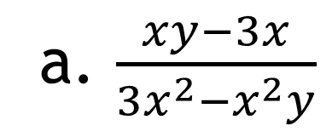
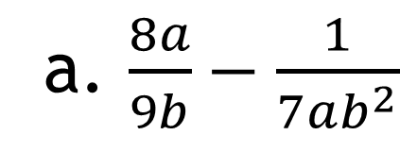
Example #3: Monomial Denominators
a. $\frac{8a}{9b}−\frac{1}{7ab^{2}}$
b. $\frac{1}{8m^{2}n}+\frac{2}{mn^{2}}$

Slide 10
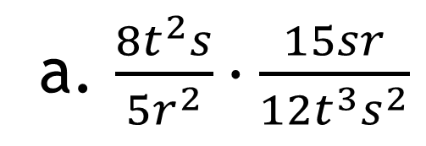
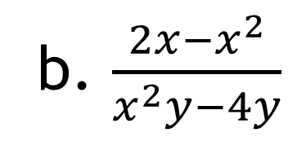
Example #3: Monomial Denominators
c. $\frac{2}{3xy}−\frac{3x}{5y}$
d. $\frac{6c}{7b^{2}}+\frac{2d}{3ab}$

Slide 11
PRACTICE #3: Monomial Denominators
a. $\frac{2}{x^{2}y}−\frac{x}{y}$
b. $\frac{7a}{15b^{2}}−\frac{b}{18ab}$

Slide 12
PRACTICE #3: Monomial Denominators
c. $\frac{5}{3m}−\frac{2}{7m}−\frac{1}{2m}$
d. $\frac{3x}{5}−\frac{1}{2x^{2}}+\frac{3}{4x}$

