Slide 1
Algebra 2 Wednesday 4-29-15
Check in/Discuss
A#8.11 page 447 #3 – 11, 16 – 25 all
Discussion/Notes/Guided Practice
8.1 – Multiplying and Dividing Rational Expressions Part 2
Assignment
A#8.12 page 447 #12 – 15, 26 – 32 all
MUST SHOW WORK TO RECEIVE CREDIT
Today, we will be able to…
simplify rational expressions and use factoring to complete this process when necessary
multiply rational expressions - polynomials
divide rational expressions - polynomials
simplify complex fractions
We will show we can do this by…
Asking and answering questions
Completing the guided practice problems
Completing the bookwork assignment
To know how well we are learning this, we will look for…
Correct answers
It is important for us to learn this (or be able to do this) because....
The concepts in Chapter 8 will help prepare students for Precalculus.
Tomorrow we will learn…
How to add and subtract rational expressions.
Yesterday we…
Learned how to simplify radical expressions and use factoring to complete the process, multiply and divide rational expressions containing monomials.
Thurs: Fri:
8.2 part 1 Notes 8.2 part 2 notes

Slide 2
Example #5: Polynomials in the numerator and denominator
a. $\frac{y−1}{5y+15}∙\frac{y^{2}+5y+6}{y^{2}+4y−5}$
b. $\frac{b^{2}+2b−35}{b^{2}−4}÷\frac{b−5}{b+2}$

Slide 3
PRACTICE#5: Polynomials in the numerator and denominator
a. $\frac{k−3}{k+1}÷\frac{1−k^{2}}{k^{2}−4k+3}$
b. $\frac{2d+5}{d^{2}+d−2}÷\frac{d+3}{d^{2}+3d+2}$

Slide 4
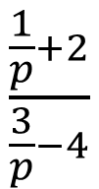
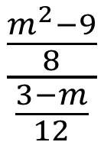
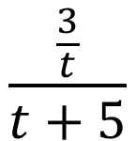
New vocabulary
Complex Fraction:
A rational expression whose numerator and/or denominator contains a rational expression.
$$\frac{\frac{a}{5}}{3b}$$
$$\frac{\frac{3}{t}}{t+5}$$
$$\frac{\frac{m^{2}−9}{8}}{\frac{3−m}{12}}$$
$$\frac{\frac{1}{p}+2}{\frac{3}{p}−4}$$
To simplify a complex fraction:

Slide 5
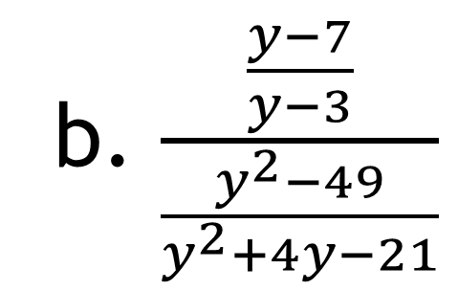
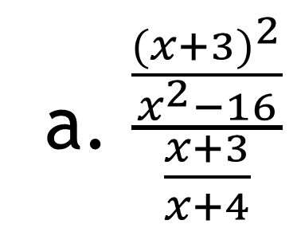
Example #6: Simplify a Complex Fraction
a. $\frac{\frac{{(x+3)}^{2}}{x^{2}−16}}{\frac{x+3}{x+4}}$
b. $\frac{\frac{y−7}{y−3}}{\frac{y^{2}−49}{y^{2}+4y−21}}$

Slide 6
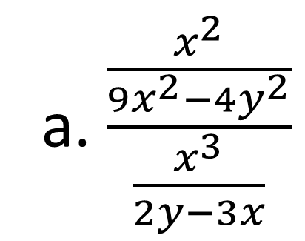
Guided Practice for Example #6: Simplify a Complex Fraction
a. $\frac{\frac{x^{2}}{{9x}^{2}−{4y}^{2}}}{\frac{x^{3}}{2y−3x}}$

Slide 7
A#8.5 page 447
#12-15, 26-32 all
MUST SHOW WORK TO RECEIVE CREDIT

