Slide 1
Algebra 2 Tuesday 4-28-15
Warm ups – see slide below
Discussion/Notes/Guided Practice
8.1 – Multiplying and Dividing Rational Expressions Part 1
Assignment
A#8.1 page 447 #3 – 11, 16 – 25 all
MUST SHOW WORK TO RECEIVE CREDIT
Today, we will be able to…
simplify rational expressions and use factoring to complete this process when necessary
multiply rational expressions
divide rational expressions
simplify complex fractions
We will show we can do this by…
Asking and answering questions
Completing the guided practice problems
Completing the bookwork assignment
To know how well we are learning this, we will look for…
Correct answers
It is important for us to learn this (or be able to do this) because....
The concepts in Chapter 8 will help prepare students for Precalculus.
Tomorrow we will learn…
How to add and subtract rational expressions.
Yesterday we…
Finished the chapter 7 test, completed the chapter 8 pretest, reviewed the success criteria for chapter 8, and reviewed how to factor polynomials.
Wed: Thurs: Fri:
8.1 Part 2 Notes 8.2 Part 1 Notes 8.2 part 2 notes

Slide 2
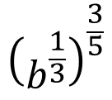
Warm-ups: Simplify or Evaluate the following
$${16}^{\frac{1}{4}}$$
$${25}^{−\frac{1}{2}}$$
$$8^{\frac{3}{2}}∙8^{\frac{5}{2}}$$
$$x^{\frac{3}{4}}{∙x}^{\frac{9}{4}}{∙x}^{3}$$
$${\left(b^{\frac{1}{3}}\right)}^{\frac{3}{5}}$$
Factor Completely:
$4x^{2}−25$ $125y^{3}−1$ $a^{2}−12a+20$

Slide 3
New vocabulary
Rational Expression:
A ratio of two polynomial expressions.
To write a fraction in simplest form:

Slide 4
Example #1: Simplify a radical expression
Under what conditions are these expressions undefined?
a. $\frac{3y(y+6)}{(y+6)(y^{2}−8y+12)}$
b. $\frac{4x^{3}(x^{2}−7x−8)}{12x(x^{2}−64)}$

Slide 5
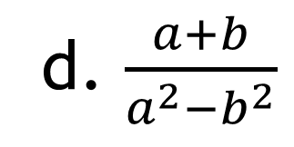
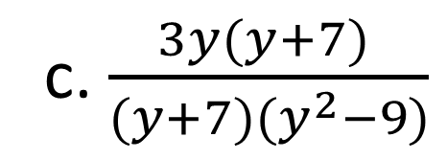
GUIDED PRACTICE#1: Simplify a radical expression
Under what conditions are these expressions undefined?
c. $\frac{3y(y+7) }{(y+7)(y^{2}−9)}$
d. $\frac{a+b}{a^{2}−b^{2}}$

Slide 6
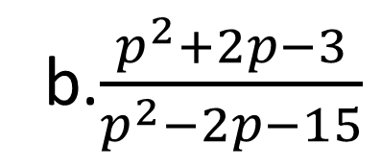
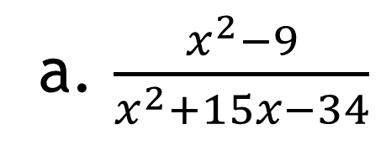
Example #2: Finding undefined values
For what values of x is the following undefined?
a. $\frac{x^{2}−9}{x^{2}+15x−34}$
b.$\frac{p^{2}+2p−3}{p^{2}−2p−15}$

Slide 7
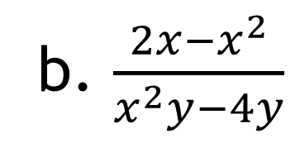
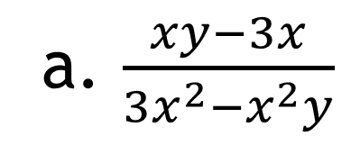
Example #3: Simplify by factoring out -1
a. $\frac{xy−3x}{3x^{2}−x^{2}y}$
b. $\frac{2x−x^{2}}{x^{2}y−4y}$

Slide 8
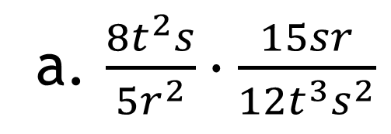
Example #4a: Multiply Rational Expressions
a. $\frac{8t^{2}s}{5r^{2}}∙\frac{15sr}{12t^{3}s^{2}}$
b. $\frac{9m^{2}n^{3}}{16ab^{4}}∙\frac{8a^{2}b}{27m^{5}n}$

Slide 9
Example #4b: Divide Rational Expressions
a. $\frac{18{ab}^{2}}{25x^{2}y^{3}}÷\frac{9b}{10xy}$
b. $\frac{14pq^{2}}{15w^{7}z^{3}}÷\frac{21p^{3}q}{35w^{3}z^{8}}$

Slide 10
A#8.1 page 447
#3-11, 16-25 all
MUST SHOW WORK TO RECEIVE CREDIT

