Slide 1
Algebra 2 Tuesday 5-19-15
Today, we will be able to…
Solve problems using independent and dependent events
We will show we can do this by…
Asking and answering questions
Completing the Guided Practice Problems
Completing the study guide
To know how well we are learning this, we will look for…
Correct answers
It is important for us to learn this (or be able to do this) because....
The concepts in Chapter 8 will help prepare students for Precalculus.
Tomorrow we will…
Understand and apply factorials.
Solve problems involving combinations and permutations
Discussion/Notes/Guided Practice
12.1: The Counting Principle
Assignment:
- 12.1 Study Guide
Yesterday we…
Completed the Chapter 8 test, reflected on chapter 8, and took the pre-test for chapter 12

Slide 2
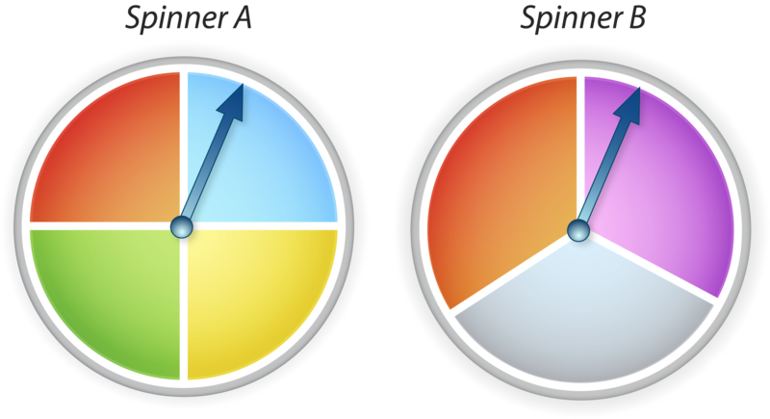
Vocabulary
______________________: The result of a single trial.
______________________: The set of all possible outcomes.
______________________: One or more outcomes of a trial.
______________________: Events that do not affect each other.
______________________: The outcome of one event does affect the outcome of another.

Slide 3
The Counting Principle

Slide 5
Example #1: Independent Events
A cafeteria offers drink choices of water, coffee, juice, and milk and salad choices of pasta, fruit, and potato. How many different combinations of drink and salad are possible?

Slide 6
PRACTICE #1: Independent Events
An ice cream shop offers a choice of two types of cones and 15 flavors of ice cream. How man different 1-scoop ice cream cones can a customer order?

Slide 7
Example #2: Fundamental Counting Principle
Dane is renting a tuxedo for prom. Once he has chosen his jacket, he must choose from three types of pants and six colors of vests. How many different ways can he select his attire for the prom?

Slide 8
PRACTICE#2: Fundamental Counting Principle
A bookshelf holds 4 different biographies and 5 different mystery novels. How many ways can one book of each type be selected?

Slide 9
Example #3: More than two independent events
If a garage door opener has a 10-digit keypad and the code to open the door is a 4-digit code, how many codes are possible?

Slide 10
PRACTICE #3: More than two independent events
Lance’s math quiz has eight true-false questions. How man different choices for giving answers to the eight questions are possible.

Slide 11
Example #4: Dependent Events
Each player in a board game uses one of six different pieces. If four players play the game, how many different ways could the players choose their pieces?

Slide 12
PRACTICE #4: Dependent Events
For a college application, Trinity must select one of five topics on which to write a short essay. She must also select a different topic from the list for a longer essay. How many ways can she choose the topics for the two essays?

