Slide 1
Algebra 2 Thursday 5-28-15
Discussion/Notes/Guided Practice
12.4 & 12.5:
Multiplying and Adding Probabilities
Assignment:
12.4: Pg 706 #1-11 all
12.5: Pg 713 #1-9 all
Today, we will be able to…
Find the probability of two independent events
Find the probability of two dependent events
Find the probability of mutually exclusive events
Find the probability of inclusive events
We will show we can do this by…
Asking and answering questions
Completing the Guided Practice Problems
Completing the study guide
To know how well we are learning this, we will look for…
Correct answers
It is important for us to learn this (or be able to do this) because....
The concepts in Chapter 8 will help prepare students for Precalculus.
Tomorrow we will…
Practice finding the probabilities of independent, dependent, mutually exclusive, and inclusive events.
Yesterday we…
Solved problems involving factorials, combinations, permutations, and the counting principle.

Slide 4
12.4 Example 1: Two Independent Events
Gabe has 9 dimes and 7 pennies in his pockets. He randomly selects one coin, looks at it, and replaces it. He then randomly selects another coin. What is the probability that both coins he selects are dimes?

Slide 5
Practice for 12.4. Example 1
At a promotional event, a radio station lets visitors spin a prize wheel. The wheel has 10 sectors of the same size for posters, 6 for T-shirts, and 2 for concert tickets. What is the probability that two consecutive visitors will win posters?

Slide 6
12.4 Example 2: Three Independent Events
When three dice are rolled, what is the probability that the first two show a 5 and the third shows an even number?

Slide 7
Practice for 12.4 Example 2
In a state lottery game, each of three cages contains 10 balls. The balls are each labeled with one of the digits 0 – 9. What is the probability that the first two balls drawn will be even and that the third will be prime?

Slide 8
12.4 Example 3: Two Dependent Events
The host of a game show is drawing chips from a bag to determine the prizes for which contestants will play. Of the 10 chips in the bag, 6 show television, 3 show vacation, and 1 shows car.
If the host draws the chips at random and does not replace them, find the probability that he draws 2 televisions.

Slide 9
Practice for 12.4 Example 3
The following week, the host of the game show draws from a bag of 20 chips, of which 11 say computer, 8 say trip, and 1 says truck.
If chips are drawn at random and without replacement, find the probability of drawing a computer, then a truck.

Slide 10
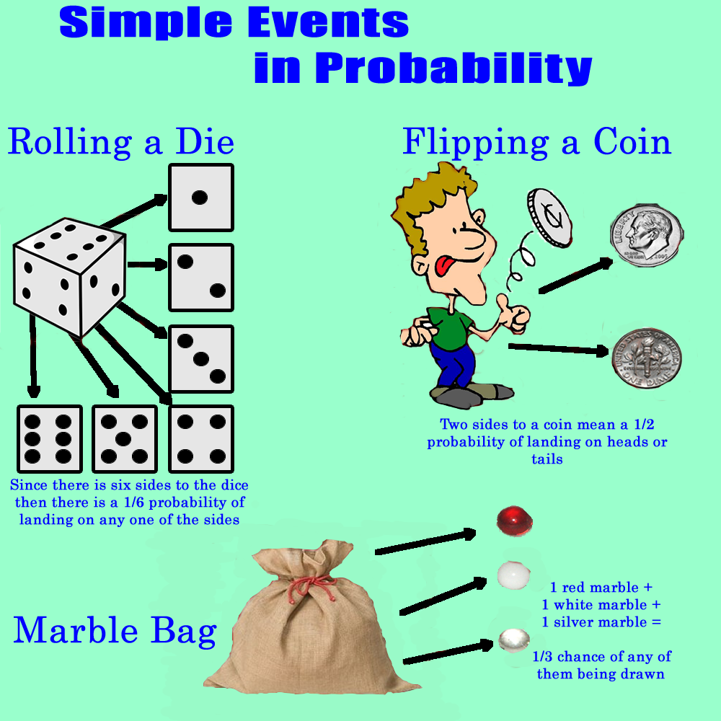

Slide 11
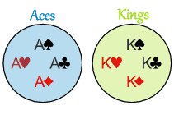
Mutually Exclusive Events
Inclusive Events

Slide 12
12.5 Example 1: Two Mutually Exclusive Events
Emme has a stack of playing cards consisting of 10 hearts, 8 spades, and 7 clubs. If she selects a card at random from this stack, what is the probability that this is a heart or a club?

Slide 13
Practice for 12.5 Example 1
One teacher must be chosen to supervise a senior class fund-raiser. There are 12 math teachers, 9 language arts teachers, 8 social studies teachers, and 10 science teachers. If the teacher is chosen at random, what is the probability that the teacher is either a language arts teacher or a social studies teacher?

Slide 14
12.5 Example 2: Three Mutually Exclusive Events
The Film Club makes a list of 9 comedies and 5 adventure movies they want to see. They plan to select 4 titles at random to show this semester. What is the probability that at least two of the films they select are comedies?

Slide 15
Practice for 12.5 Example 2
The Trojans basketball team can send 5 players to a basketball clinic. Six guards and 5 forwards would like to attend the clinic. If the players are selected at random, what is the probability that at least 3 of the players selected to attend the clinic will be forwards?

Slide 16
12.5 Example 3: Inclusive Events
There are 2400 subscribers to an Internet service provider. Of these, 1200 own Brand A computers, 500 own Brand B, and 100 own both A and B. What is the probability that a subscriber selected at random owns either Brand A or Brand B?

Slide 17
Practice for 12.5 Example 3
Sixty plastic discs, each with one of the numbers from 1 to 60, are in a bag. Trey will win a game if he can pull out any disc with a number divisible by 2 or 3. What is the probability that Trey will win?

